Slide 1
Covalent substances
COVALENT NETWORK SUBSTANCES

Slide 2
COVALENT NETWORK SUBSTANCES
COVALENT network SUBSTANCES ARE FORMED WHEN NEIGHBOURING ATOMS SHARE ELECTRONS
Like ionic & covalent molecular substances they try to obey the octet rule – attain 8 outer (valence) electrons
covalent network bonding occurs in non-metal elements & non-metal compounds containing elements near the centre of the periods

Slide 3
COVALENT NETWORK SUBSTANCES
have high melting & boiling points
are hard & brittle
are non-conductors (except for graphite)

Slide 4
common examples
Elements
Si Silicon
C Carbon
Compounds
SiO₂ Silicon dioxide
SiC Silicon carbide

Slide 5
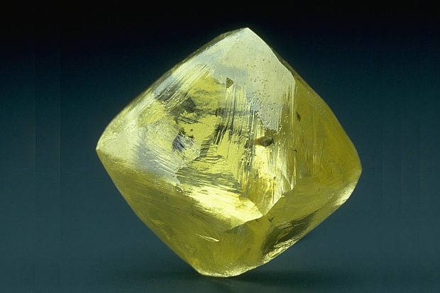
diamond

Slide 6
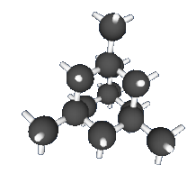
diamond
C
C C C
C
Each carbon atom is bonded to 4 others by a single covalent bond.

Slide 7
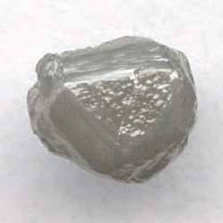
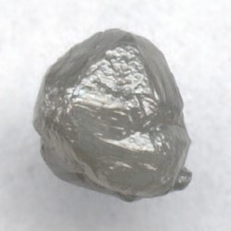
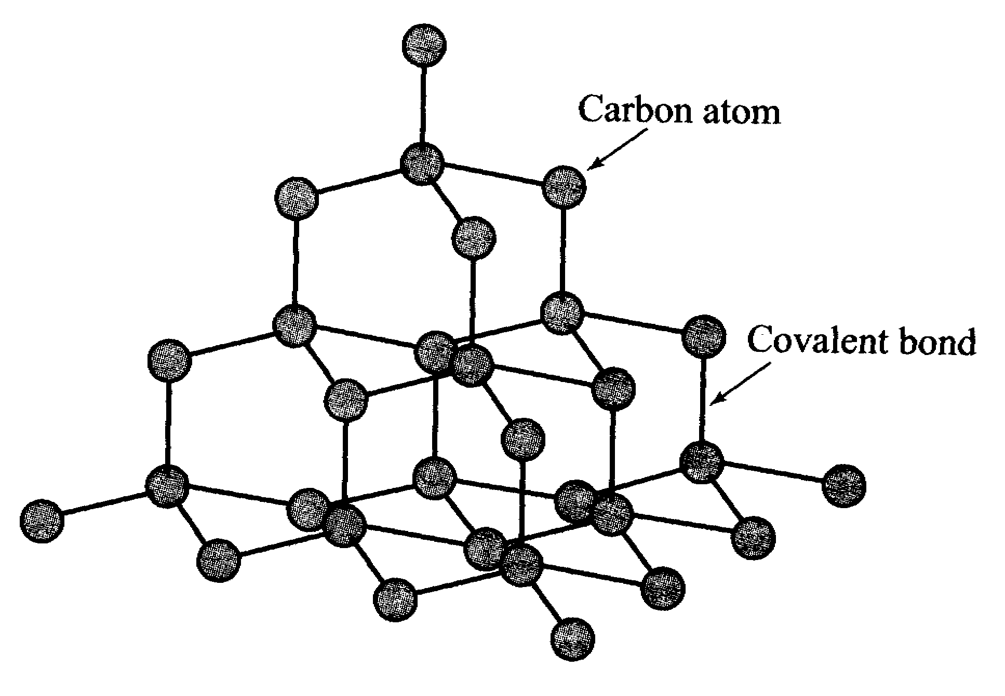
diamond

Slide 8
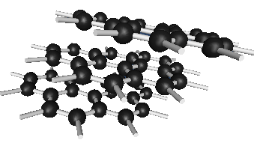
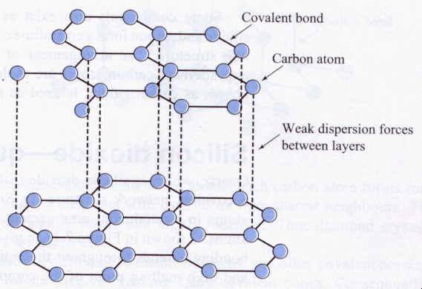
Graphite - C

Slide 9
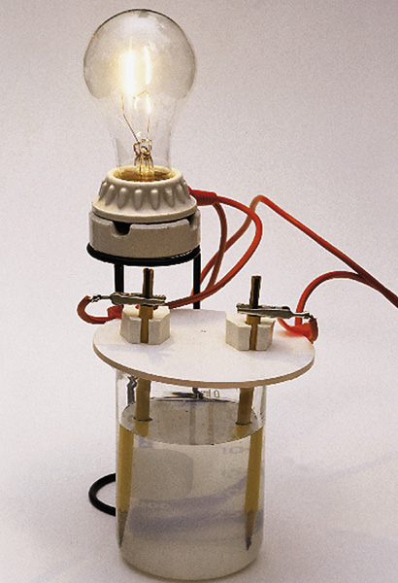

Slide 10
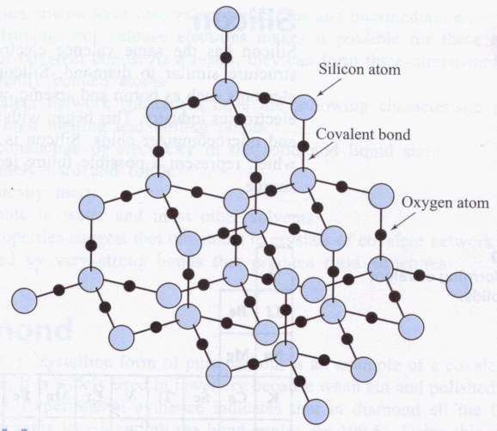
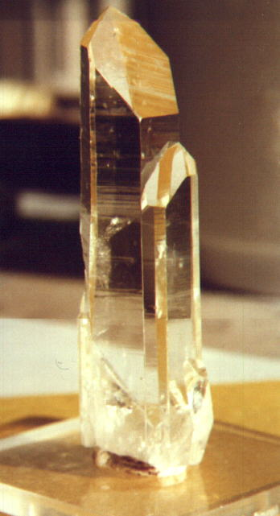
Quartz - SiO₂ Has a similar structure to that of diamond

Slide 11
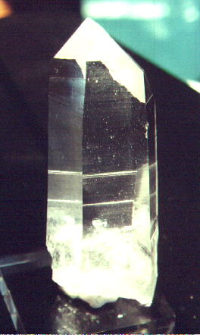
Quartz usa

Slide 12
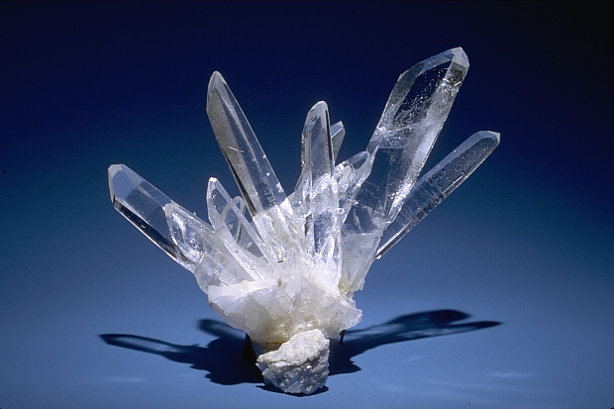

Slide 13
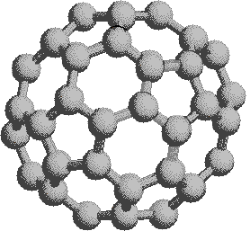

Slide 14
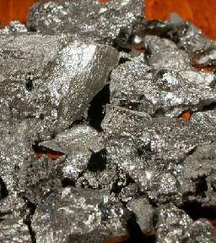
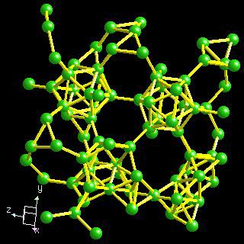
Boron

